Slide 1
6.7 Monitors Problems with Semaphores
Incorrect use of semaphore operations
….
signal (mutex)
….
wait (mutex)
….
（顺序颠倒）
….
wait (mutex)
….
wait (mutex)
….
(signal误为wait)
….
wait (mutex)
….
….
Omitting of wait (mutex) or signal (mutex) (or both)

Slide 2
信号量及wait、signal操作存在的问题
信号量及wait、signal操作使用不当，会违反同步机制应遵循的规则。
wait与signal位置倒置－mutual exclusion is violated ；
将signal误写成wait－deadlock will occur；
遗漏wait或signal－ mutual exclusion is violated or deadlock will occur；
wait的顺序不当－ deadlock will occur；
solution
提供更高层的方便用户同步机制，系统（e.g.compiler）将其映射到底层的信号量及wait、signal操作；
monitor

Slide 3
6.7.1 Usage
A high-level abstraction that provides a convenient and effective mechanism for process synchronization；
Only one process may be active within the monitor at a time；
Monitor要互斥
monitor monitor-name
{
// shared variable declarations
procedure P1 (…) { …. }
…
procedure Pn (…) {……}
Initialization code ( ….) { … }
…
}
}

Slide 4
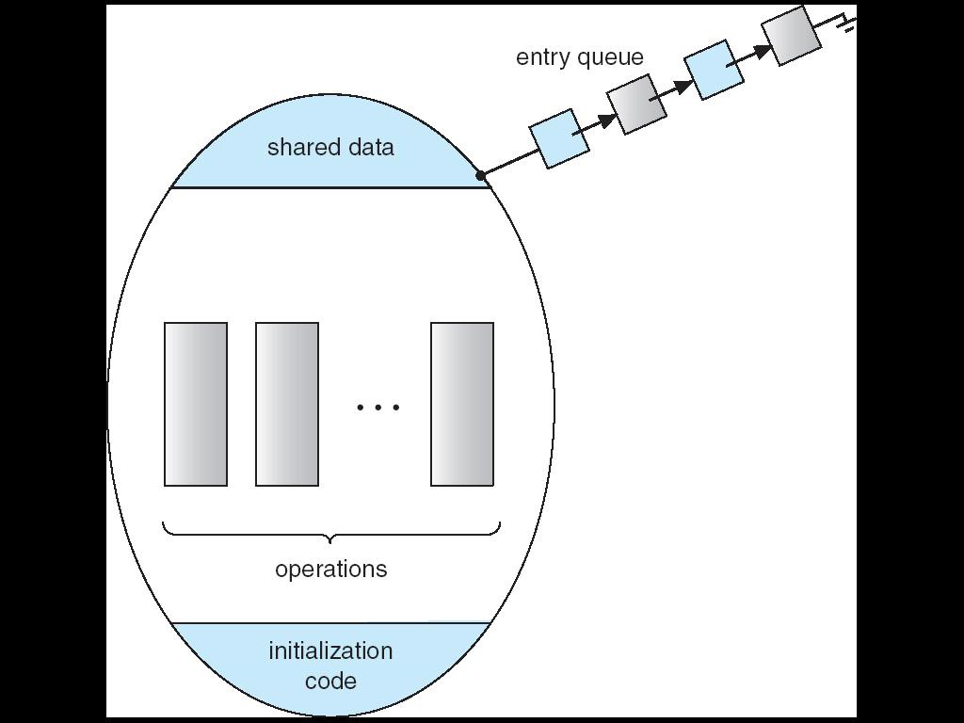
Schematic view of a Monitor
Only one process may be active within the monitor at a time；
等待访问管程的进程队列
Figure 6.17 Schematic view of a Monitor

Slide 5
管程下的wait and signal operation
可把管程的定义理解为一个类定义； 与一般的类不同的是，管程有条件变量，用于控制进程之间的同步；
并发的进程要互斥访问管程；
Only one process may be active within the monitor at a time；
当某进程通过管程请求临界资源而未满足时，管程调用wait原语使该进程等待，并将它排在等待队列上；
当另一进程访问完并释放之后，管程调用signal原语唤醒等待队列中的某个进程；

Slide 6
Condition Variable
通常，进程等待的原因有多个，为了区分这些原因，引入条件变量；
例如在生产者－消费者问题中，进程可以在empty、full或mutex信号量对应的等待队列中等待；
在不同信号量的等待队列中的进程，等待的原因是不同的；
管程中对每个条件变量，都予以声明；
Condition x，y
该变量置于wait和signal之前，即可表示为
x.wait, x.signal
e.g. empty.wait：等待空缓冲区
empty.signal：唤醒等待空缓冲区的进程

Slide 7
Condition Variable
To allow a process to wait within the monitor, a condition variable must be declared, as: condition x, y;
Condition variable can only be used with the operations wait and signal.
The operation x.wait() means that the process invoking this operation is suspended until another process invokes x.signal();
The x.signal operation resumes exactly one suspended process (if any) that invoked x.wait (). If no process is suspended, then the signal operation has no effect.

Slide 8
Condition Variables
condition x, y;
Two operations on a condition variable:
x.wait () – a process that invokes the operation is suspended.
x.signal () – resumes one of processes (if any) that invoked x.wait ()
根据x.signal ()的语义，如果没有在条件变量x中等待的进程，也可以执行x.signal()，只是执行x.signal()后不会产生任何效果

Slide 9
x.signal()
当一个进程P执行了x.signal()，而进程Q正在条件变量x的等待队列中，Q将被唤醒，并可被调度执行
由于管程需要互斥访问，因此P与Q两个进程中只有一个能够运行，否则管程中会有两个进程同时在执行（多处理机系统中）；
Two possibilities exist:
1. Signal and wait. P either waits until Q leaves the monitor or waits for another condition.
P执行x.signal()后，唤醒了进程Q，则P进入等待
P要么等到Q执行后离开管程，要么等待另一个条件。
2. Signal and continue. Q either waits until P leaves the monitor or waits for another condition.
P执行x.signal()后，唤醒了进程Q，则P继续执行，Q进入等待
Q要么等到P执行后离开管程，要么等待另一个条件

Slide 10
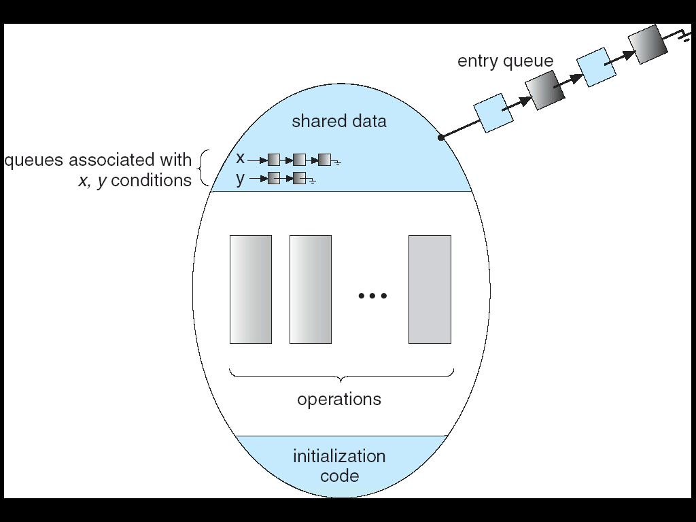
Monitor with Condition Variables
等待访问管程的进程队列
利用条件变量x,y区分进程等待的原因
Figure 6.18 Monitor with Condition Variables

Slide 11
例：管程的使用--利用管程解决P-C问题
建立一个管程，命名为PC。
其中，管程包含两个过程：
Put(item)
生产者利用该过程，将自己生成的消息放到缓冲池中；
并利用整型变量count来表示在缓冲池中已有的消息数；
当count ≥n 时，表示缓冲池已满，生产者等待；
get(item)
消费者利用该过程，从缓冲池中获取一个消息；
当count ≤0 时，表示缓冲池中无可用消息，消费者等待；

Slide 12
利用管程解决生产者－消费者问题
Producer: //生产者
do {
…
produce an item in nextp;
pc.put(nextp);
…
} while (1);
Consumer: //消费者
do {
…
pc.get(nextc);
consumer the item in nextc;
…
} while (1);

Slide 13
管程的定义
monitor pc
{
int in,out,count;
item buffer[n];
condition empty,full; //条件变量
void put(item i); // following slides
void get(item i); // following slides
void init() {
in=0;
out=0;
count=0;
}
}

Slide 14
void put(item i)
void put(item i)
{
if (count >= n) empty.wait; //缓冲池满，等待空缓冲区
buffer[in] = i;
in = (in+1)%n;
count++;
//if (full.queue) full.signal; //有消费者等待，则唤醒之
full.signal; //有消费者等待，则唤醒之，否则，无效果
}

Slide 15
void get(item i)
void get(item i)
{
if (count <= 0) full.wait; //缓冲池空，等待满缓冲区
i = buffer[out] ;
out = (out+1)%n;
count- -;
//if (empty.queue) empty.signal; //若有生产者等待，则唤醒 之
empty.signal; //若有生产者等待，则唤醒之,否则，无效果
}

Slide 16
利用管程解决生产者－消费者问题
Producer: //生产者
do {
…
produce an item in nextp;
pc.put(nextp);
…
} while (1);
Consumer: //消费者
do {
…
pc.get(nextc);
consumer the item in nextc;
…
} while (1);

Slide 17
习题 6.13 （ Bounded Buffer Problem） 另一种描述
monitor bounded_buffer {
int items[MAX_ITEMS];
int numItems = 0; //满缓冲区个数
condition empty, full;
void produce(int v) {
//如果缓冲池满，则等待空缓冲区
if (numItems == MAX_ITEMS)
empty.wait();
items[numItems++] = v;
full.signal();
}
int consume() {
int retVal;
//如果缓冲池空，则等待满缓冲区
if (numItems == 0)
full.wait();
retVal = items[--numItems];
empty.signal();
return retVal;
}
} //monitor

Slide 18
讨论
上述示例中，没有考虑管程的互斥访问问题
如何保证管程的互斥访问？

Slide 19
讨论
上述示例中，没有考虑管程的互斥访问问题
如何保证管程的互斥访问？
如果系统支持管程机制，则
由系统提供管程的互斥访问机制实现管程的互斥访问
Only one process may be active within the monitor at a time；
如果系统不支持管程机制，管程由用户自己定义，则
可以在put()与get()中设置一个互斥信号量来实现
也可以在put()与get()中使用系统提供的lock机制实现
参见
实验6中示例程序；
参见 Nachos code/monitor/ring.cc中的put()与get()

Slide 20
6.7.2 Dining-Philosophers Solution Using Monitors
筷子（资源）的分配由管程来控制；
Each philosopher i invokes the operations pickup()
and putdown() in the following sequence:
dp.pickup (i) //如果第i个哲学家自己饥饿，且左右两只筷子同时
// 空闲，则吃饭；否则，等待；
EAT;
dp.putdown (i) // 第i个哲学家放下筷子，同时测试左右邻居
// 等待吃饭；
// 如果有等待的哲学家，则唤醒之；

Slide 21
Solution to Dining Philosophers(cont)
每个哲学家的状态初始化为 state[i] = THINKING;
第i个哲学家具备吃饭的条件是：
1、自己状态为饥饿，即state[i] = HUNGRY;
2、左右两个哲学家都不在吃饭，即两边的筷子时空闲的，能同时拿起左右两只筷子
因此，一个哲学家想要吃饭，首先将自己的状态设置为HUNGRY，然后测试左右两只筷子是否可用；
如果可用，将自己的状态设为EATING,开吃；(见pickup(i))
如果不可用，自己状态维持HUNGRY(!=EATING)，并进入等待；
当一个哲学家吃完饭，将自己的状态设置为THINKING，然后放下筷子，然后测试左右哲学家是否在等待吃饭，如果等待，则唤醒他们。（见putdown(i)）

Slide 22
Solution to Dining Philosophers(cont)
monitor DP
{
enum { THINKING; HUNGRY, EATING) state [5] ;
condition self [5]; //为每个哲学家分别设置一个条件变量
void pickup (int i) {
state[i] = HUNGRY;
//如果一个哲学家具备吃饭的条件，则把自己的状态设为正在吃饭，
//如果自己原来等待吃饭，则被唤醒；
test(i); // test(i)后，state[i] == EATING ，或 state[i] != EATING
if (state[i] != EATING) self [i].wait; //如果测试后发现两只筷子不能同时使用，则等待
}
void putdown (int i) {
state[i] = THINKING;
// test left and right neighbors
test((i + 4) % 5); //放下左筷子，测试左边的哲学家是否等待吃饭，如果是，唤醒之；
test((i + 1) % 5); //放下右筷子，测试右边的哲学家是否等待吃饭，如果是，唤醒之；
}

Slide 23
Solution to Dining Philosophers (cont)
void test (int i) {
//如果左右两个哲学家都不在吃饭且自己饥饿，则把自己的状态设为吃，
//如果自己原来等待吃饭，则被唤醒
if ( (state[(i + 4) % 5] != EATING) && //左边哲学家未吃饭
(state[i] == HUNGRY) && //自己饥饿
(state[(i + 1) % 5] != EATING) ) { //右边哲学家未吃饭
state[i] = EATING ; //自己具备了吃饭的条件
//下句由putdown(i)使用
self[i].signal () ; //如果该哲学家不能同时拿起两只筷子,
//则state[i] != EATING，进入等待状态；
// (见void pickup (int i))
//当邻居哲学家放下筷子后，经过测试如果发现自己具
//备吃饭的条件，则被唤醒(见putdown (i))
} //if
} //test
initialization_code() {
for (int i = 0; i < 5; i++)
state[i] = THINKING;
}
}

Slide 24
6.7.3 Implementing a Monitor Using Semaphores
一般情况下，可以采用下述两种方法实现管程
基于锁机制（lock）
基于信号量（semaphore）
Hoare and Brinch-Hansen解决方案
上述两种方法在Nachos的 code/monitor/synch.cc中均有实现
其使用方法可参阅code/monitor/ring.cc

Slide 25
Implementing a Monitor Using Semaphores
For each monitor, a semaphore mutex (initialized to 1) is provided.（to ensure the monitor is accessed mutually）
A process
must execute wait(mutex) before entering the monitor and
must execute signal(mutex) after leaving the monitor
Suppose a signaling process must wait until the resumed process either leaves or waits (signal and wait)
an additional semaphore, next, is introduced, initialized to 0, on which the signaling processes may suspend themselves.
An integer variable next_count is also provided to count the number of processes suspended on next.

Slide 26
Monitor Implementation Using Semaphores
Variables
semaphore mutex; // (initially = 1)
semaphore next; // (initially = 0)
int next_count = 0;
Each procedure F will be replaced by
wait(mutex);
…
body of F;
…
if (next_count > 0)
signal(next)
else
signal(mutex);
Mutual exclusion within a monitor is ensured.

Slide 27
Monitor Implementation
For each condition variable x, we have:
semaphore x_sem; // (initially = 0)
int x_count = 0;
The operation x.wait can be implemented as:
x_count++;
if (next_count > 0)
signal(next);
else
signal(mutex);
wait(x_sem);
x_count--;

Slide 28
Monitor Implementation
The operation x.signal can be implemented as:
if (x_count > 0) {
next_count++;
signal(x_sem);
wait(next);
next_count--;
}

Slide 29
6.7.4 Resuming Processes Within a Monitor
If several processes are suspended on condition x, and an x.signal () operation is executed by some process, then how do we determine which of the suspended processes should be resumed next?
FCFS
One simple solution is to use an FCFS ordering, so that the process waiting the longest is resumed first
Priority-based
a priority number is stored with the name of the process that is suspended
When x.signal () is executed, the process with the smallest associated priority number is resumed next
x.wait (c) ,where c is an integer expression that is evaluated when the wait() operation is executed.

Slide 30
6.8 Synchronization Examples
Solaris
Windows XP
Linux
Pthreads

Slide 31
Solaris Synchronization
Implements a variety of locks to support multitasking, multithreading (including real-time threads), and multiprocessing
Uses adaptive mutexes for efficiency when protecting data from short code segments
Uses condition variables and readers-writers locks when longer sections of code need access to data
Uses turnstiles to order the list of threads waiting to acquire either an adaptive mutex or reader-writer lock

Slide 32
Windows XP Synchronization
Uses interrupt masks to protect access to global resources on uniprocessor systems;
Uses spinlocks on multiprocessor systems
Also provides dispatcher objects which may act as either mutexes and semaphores
Dispatcher objects may also provide events
An event acts much like a condition variable
Windows API
互斥对象：mutex（create、open、release）
临界区：critical section
信号量：semaphore
事件event：相当于触发器，通知一个或多个线程某事件的出现；

Slide 33
Linux Synchronization
Linux:
disables interrupts to implement short critical sections
Linux provides:
semaphores
spin locks

Slide 34
Pthreads Synchronization
Pthreads API is OS-independent
It provides:
mutex locks
condition variables
Non-portable extensions include:
read-write locks
spin locks

Slide 35
Eaxmple of pthread mutex lock
int value=5;
void *runner1(void *param);
void *runner2(void *param);
pthread_mutex_t mutex; //mutex lock
int main(int argc, char *argv[])
{
pthread_mutex_init(&mutex,NULL); //create lock
pthread_t tid1,tid2;
pthread_attr_t attr1,attr2;
//============
pthread_attr_init(&attr1);
pthread_create(&tid1,&attr1,runner1,NULL);
//=============
pthread_attr_init(&attr2);
pthread_create(&tid2,&attr2,runner2,NULL);
printf(“value=%d\n”,value); //理论上:4,5,6
pthread_join(tid1,NULL);
pthread_join(tid2,NULL);
}//main
问：输出结果是什么？
//理论上，该程序存在问题，缺少对共享变量value的互斥访问
//threads
void *runner1(void *param)
{
pthread_mutex_lock(&mutex);
value += 1;
pthread_mutex_unlock(&mutex);
pthread_exit(0);
}
void *runner2(void *param)
{
pthread_mutex_lock(&mutex);
value -= 1;
pthread_mutex_unlock(&mutex);
pthread_exit(0);
}

Slide 36
Atomic Transactions
System Model
Log-based Recovery
Checkpoints
Concurrent Atomic Transactions
Windows的系统还原

Slide 37
System Model
Assures that operations happen as a single logical unit of work, in its entirety, or not at all
Related to field of database systems
Challenge is assuring atomicity despite computer system failures
Transaction - collection of instructions or operations that performs single logical function
Here we are concerned with changes to stable storage – disk
Transaction is series of read and write operations
Terminated by commit (transaction successful) or abort (transaction failed) operation
Aborted transaction must be rolled back to undo any changes it performed

Slide 38
Types of Storage Media
Volatile storage – information stored here does not survive system crashes
Example: main memory, cache
Nonvolatile storage – Information usually survives crashes
Example: disk and tape
Stable storage – Information never lost
Not actually possible, so approximated via replication or RAID to devices with independent failure modes
Goal is to assure transaction atomicity where failures cause loss of information on volatile storage

Slide 39
Log-Based Recovery
Record to stable storage information about all modifications by a transaction
Most common is write-ahead logging
Log on stable storage, each log record describes single transaction write operation, including
Transaction name
Data item name
Old value
New value
<T_{i} starts> written to log when transaction T_{i} starts
<T_{i} commits> written when T_{i} commits
Log entry must reach stable storage before operation on data occurs

Slide 40
Log-Based Recovery Algorithm
Using the log, system can handle any volatile memory errors
Undo(T_{i}) restores value of all data updated by T_{i}
Redo(T_{i}) sets values of all data in transaction T_{i} to new values
Undo(T_{i}) and redo(T_{i}) must be idempotent
Multiple executions must have the same result as one execution
If system fails, restore state of all updated data via log
If log contains <T_{i} starts> without <T_{i} commits>, undo(T_{i})
If log contains <T_{i} starts> and <T_{i} commits>, redo(T_{i})

Slide 41
Checkpoints
Log could become long, and recovery could take long
Checkpoints shorten log and recovery time.
Checkpoint scheme:
Output all log records currently in volatile storage to stable storage
Output all modified data from volatile to stable storage
Output a log record <checkpoint> to the log on stable storage
Now recovery only includes Ti, such that Ti started executing before the most recent checkpoint, and all transactions after Ti All other transactions already on stable storage

Slide 42
Concurrent Transactions
Must be equivalent to serial execution – serializability
Could perform all transactions in critical section
Inefficient, too restrictive
Concurrency-control algorithms provide serializability

Slide 43
Serializability
Consider two data items A and B
Consider Transactions T₀ and T₁
Execute T₀, T₁ atomically
Execution sequence called schedule
Atomically executed transaction order called serial schedule
For N transactions, there are N! valid serial schedules

Slide 44
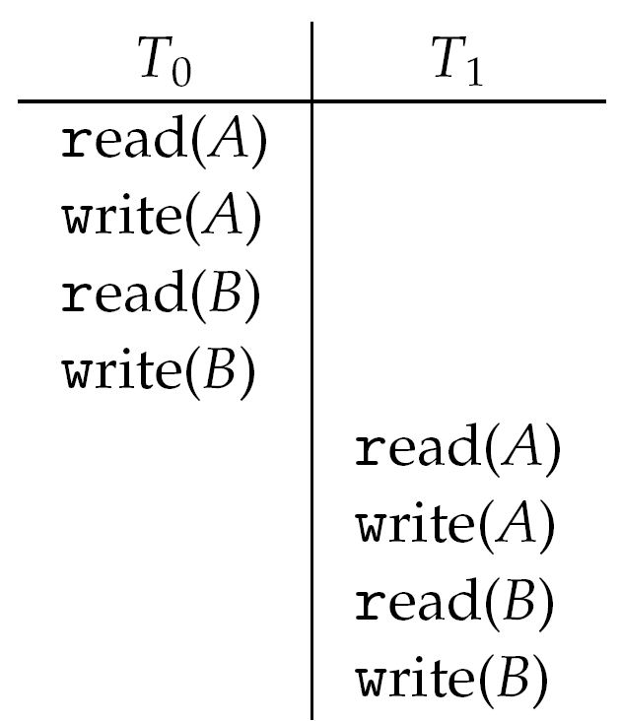
Schedule 1: T₀ then T₁

Slide 45
Nonserial Schedule
Nonserial schedule allows overlapped execute
Resulting execution not necessarily incorrect
Consider schedule S, operations O_{i}, O_{j}
Conflict if access same data item, with at least one write
If O_{i}, O_{j} consecutive and operations of different transactions & O_{i} and O_{j} don’t conflict
Then S’ with swapped order O_{j} O_{i} equivalent to S
If S can become S’ via swapping nonconflicting operations
S is conflict serializable

Slide 46
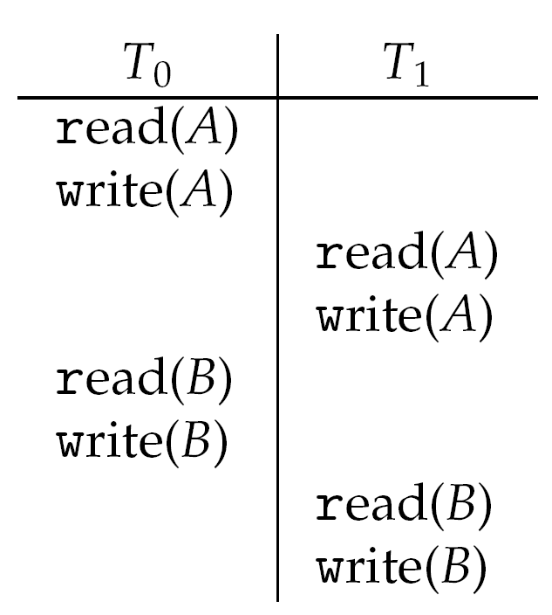
Schedule 2: Concurrent Serializable Schedule

Slide 47
Locking Protocol
Ensure serializability by associating lock with each data item
Follow locking protocol for access control
Locks
Shared – T_{i} has shared-mode lock (S) on item Q, T_{i} can read Q but not write Q
Exclusive – Ti has exclusive-mode lock (X) on Q, T_{i} can read and write Q
Require every transaction on item Q acquire appropriate lock
If lock already held, new request may have to wait
Similar to readers-writers algorithm

Slide 48
Two-phase Locking Protocol
Generally ensures conflict serializability
Each transaction issues lock and unlock requests in two phases
Growing – obtaining locks
Shrinking – releasing locks
Does not prevent deadlock

Slide 49
Timestamp-based Protocols
Select order among transactions in advance – timestamp-ordering
Transaction T_{i} associated with timestamp TS(T_{i}) before T_{i} starts
TS(T_{i}) < TS(T_{j}) if Ti entered system before T_{j}
TS can be generated from system clock or as logical counter incremented at each entry of transaction
Timestamps determine serializability order
If TS(T_{i}) < TS(T_{j}), system must ensure produced schedule equivalent to serial schedule where T_{i} appears before T_{j}

Slide 50
Timestamp-based Protocol Implementation
Data item Q gets two timestamps
W-timestamp(Q) – largest timestamp of any transaction that executed write(Q) successfully
R-timestamp(Q) – largest timestamp of successful read(Q)
Updated whenever read(Q) or write(Q) executed
Timestamp-ordering protocol assures any conflicting read and write executed in timestamp order
Suppose Ti executes read(Q)
If TS(T_{i}) < W-timestamp(Q), Ti needs to read value of Q that was already overwritten
read operation rejected and T_{i} rolled back
If TS(T_{i}) ≥ W-timestamp(Q)
read executed, R-timestamp(Q) set to max(R-timestamp(Q), TS(T_{i}))

Slide 51
Timestamp-ordering Protocol
Suppose Ti executes write(Q)
If TS(T_{i}) < R-timestamp(Q), value Q produced by T_{i} was needed previously and T_{i} assumed it would never be produced
Write operation rejected, T_{i} rolled back
If TS(T_{i}) < W-tiimestamp(Q), T_{i} attempting to write obsolete value of Q
Write operation rejected and T_{i} rolled back
Otherwise, write executed
Any rolled back transaction T_{i} is assigned new timestamp and restarted
Algorithm ensures conflict serializability and freedom from deadlock

Slide 52
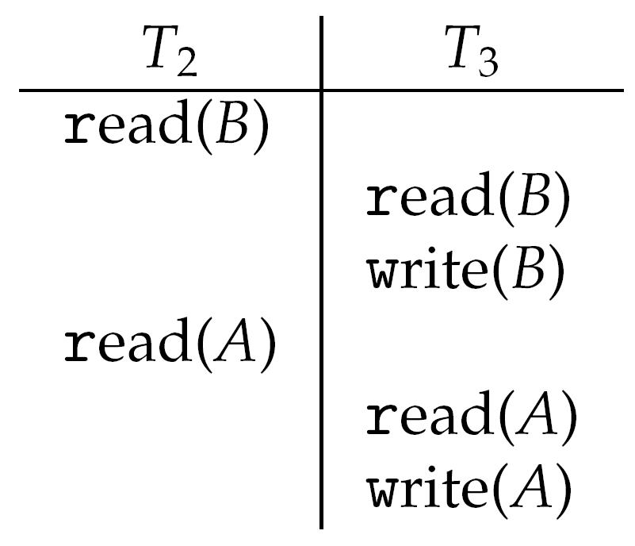
Schedule Possible Under Timestamp Protocol

Slide 53
Java Synchronization

Slide 54
Java Synchronization
Synchronized, wait(), notify() statements
Multiple Notifications (notifyall())
Block Synchronization
Java Semaphores
Java Monitors

Slide 55
synchronized Statement
Every object has a lock associated with it.
Calling an ordinary method the lock is ignored.
But, calling a synchronized method requires “owning” the lock.

Slide 56
synchronized Statement
If the lock is available when a synchronized method is called , the calling thread becomes the owner of the object’s lock.
If a calling thread does not own the lock (another thread already owns it), the calling thread is blocked and is placed in the entry set for the object’s lock.
The lock is released when a thread exits the synchronized method, and the JVM selects an arbitrary thread from this set as the new owner of the lock.

Slide 57
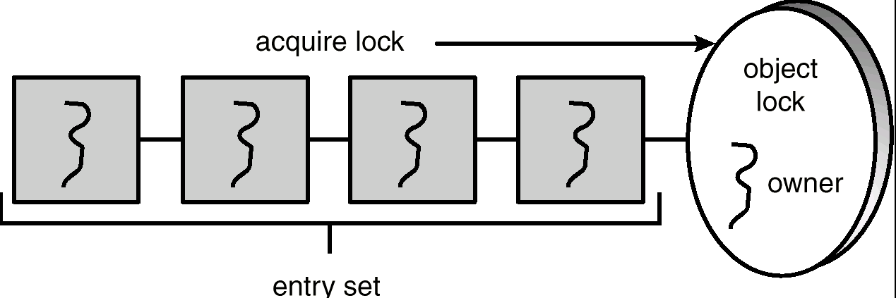
Entry Set
注：Entry set 中的线程处于阻塞状态
也有的处于runnable状态（后面还要介绍）；

Slide 58
enter() Method - busy waiting without synchronized
public void enter(Object item) {
while (count == BUFFER_SIZE) ;
++count;
buffer[in] = item;
in = (in + 1) % BUFFER_SIZE;
}

Slide 59
remove() Method - busy waiting without synchronized
public Object remove() {
Object item;
while (count == 0) ;
--count;
item = buffer[out];
out = (out + 1) % BUFFER_SIZE;
return item;
}

Slide 60
Problems
The specification for the JVM does not indicates whether threads are time-sliced or not. It is up to the particular implementation of the JVM.
Usually, the JVM schedules threads using a preemptive, priority-based schedules algorithm.
So if no higher priority threads arrive, the executing thread will never relinquishes control of the CPU;

Slide 61
problems
Race condition:
shared variables: count, in and out
Solution:
synchronized method
Busy waiting
Maybe the executing thread never relinquishes control of the CPU;
waste time
other threads have no opportunity to run;
Solution(以后考虑)
yield();

Slide 62
enter() Method - busy waiting with synchronized
public synchronized void enter(Object item) {
while (count == BUFFER_SIZE) ;
++count;
buffer[in] = item;
in = (in + 1) % BUFFER_SIZE;

Slide 63
remove() Method - busy waiting with synchronized
public synchronized Object remove() {
Object item;
while (count == 0) ;
--count;
item = buffer[out];
out = (out + 1) % BUFFER_SIZE;
return item;
}

Slide 64
problems
Busy waiting
Maybe the executing thread never relinquishes control of the CPU;
Solution:
yield();

Slide 65
problems
Can leads to a deadlock;
Assume the producer owns the lock and the buffer is full, it is busy waiting and still keeps the lock.
When the consumer is scheduled to run, the consumer will be blocked and is placed in the entry set for the object’s lock.
Then
The producer is waiting for the consumer to free space in the buffer;
The consumer is blocked waiting for the producer to release the lock.

Slide 66
yield() method
When a thread invokes the yield() method, the thread stays in the runnable state, but it relinquishes control of the CPU and allows the JVM to select to run anther runnable thread of equal priority.
The yield() method makes more effective use of the CPU than busy waiting does.

Slide 67
synchronized enter() Method with yield
public synchronized void enter(Object item) {
while (count == BUFFER_SIZE)
Thread.yield();
++count;
buffer[in] = item;
in = (in + 1) % BUFFER_SIZE;
}

Slide 68
synchronized remove() Method with yield
public synchronized Object remove() {
Object item;
while (count == 0)
Thread.yield();
--count;
item = buffer[out];
out = (out + 1) % BUFFER_SIZE;
return item;
}

Slide 69
problems
Assume the producer owns the lock and the buffer is full;
The producer still keeps the lock;
When the consumer has an opportunity to be scheduled to run, the consumer will be blocked and is placed in the entry set for the object’s lock.
Then
The producer is waiting for the consumer to free space in the buffer;
The consumer is blocked waiting for the producer to release the lock.
So, Using either busy waiting or yielding could potentially lead to a deadlock.

Slide 70
The wait() Method
When a thread calls wait(), the following occurs:
the thread releases the object lock.
thread state is set to blocked.
thread is placed in the wait set.

Slide 71
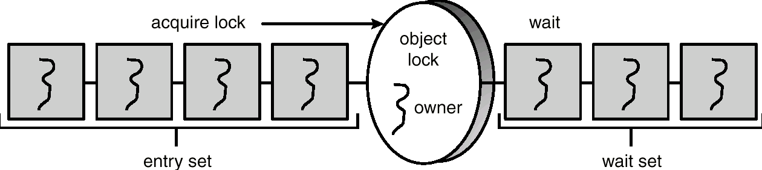
Entry and Wait Sets
1、own the lock
2、blocked or runnable
1、release the lock
2、blocked

Slide 72
The notify() Method
When a thread calls notify(), the following occurs:
selects an arbitrary thread T from the wait set.
moves T to the entry set.
sets T to Runnable.
T can now compete for the object’s lock again.

Slide 73
enter() with wait/notify Methods
public synchronized void enter(Object item) {
while (count == BUFFER_SIZE)
try {
wait();
}
catch (InterruptedException e) { }
}
++count;
buffer[in] = item;
in = (in + 1) % BUFFER_SIZE;
notify();
}

Slide 74
remove() with wait/notify Methods
public synchronized Object remove() {
Object item;
while (count == 0)
try {
wait();
}
catch (InterruptedException e) { }
--count;
item = buffer[out];
out = (out + 1) % BUFFER_SIZE;
notify();
return item;
}

Slide 75
problems
notify() selects an arbitrary thread from the wait set.
This may not be the thread that you want to be selected.
Java does not allow you to specify the thread to be selected.
Consider the case where there are multiple threads in the wait set and more than one condition for which to wait. (为完成一件事情需要满足多个条件)
It is possible that a thread whose condition is still unmet may be the thread that receives the notification.
Then this thread will be blocked again;
For the worst case, the threads in the wait set were notified in a bad sequence, and they wait for other unmet conditions and then all of them would be blocked again.
Can also leads to a deadlock;

Slide 76
Multiple Notifications
notifyAll() removes ALL threads from the wait set and places them in the entry set. This allows the threads to decide among themselves who should proceed next.
notifyAll() is a conservative strategy that works best when multiple threads may be in the wait set.

Slide 77
enter() with wait/notifyall Methods
public synchronized void enter(Object item) {
while (count == BUFFER_SIZE)
try {
wait();
}
catch (InterruptedException e) { }
}
++count;
buffer[in] = item;
in = (in + 1) % BUFFER_SIZE;
notifyall();
}

Slide 78
remove() with wait/notify Methods
public synchronized Object remove() {
Object item;
while (count == 0)
try {
wait();
}
catch (InterruptedException e) { }
--count;
item = buffer[out];
out = (out + 1) % BUFFER_SIZE;
notifyall();
return item;
}

Slide 79
No deadlock occurs, but low efficient

Slide 80
Reader Methods with Java Synchronization
public class Database {
public Database() {
readerCount = 0;
dbReading = false;
dbWriting = false;
}
public synchronized int startRead() { /* see next slides */ }
public synchronized int endRead() { /* see next slides */ }
public synchronized void startWrite() { /* see next slides */ }
public synchronized void endWrite() { /* see next slides */ }
private int readerCount;
private boolean dbReading;
private boolean dbWriting;
}

Slide 81
startRead() Method
public synchronized int startRead() {
while (dbWriting == true) {
try {
wait();
}
catch (InterruptedException e) { }
++readerCount;
if (readerCount == 1)
dbReading = true;
return readerCount;
}

Slide 82
endRead() Method
public synchronized int endRead() {
--readerCount
if (readerCount == 0)
db.notifyAll();
return readerCount;
}

Slide 83
Writer Methods
public void startWrite() {
while (dbReading == true || dbWriting == true)
try {
wait();
}
catch (InterruptedException e) { }
dbWriting = true;
}
public void endWrite() {
dbWriting = false;
notifyAll();
}

Slide 84
Block Synchronization
Blocks of code – rather than entire methods – may be declared as synchronized.
This yields a lock scope that is typically smaller than a synchronized method.

Slide 85
Block Synchronization (cont)
Object mutexLock = new Object();
. . .
public void someMethod() {
// non-critical section
synchronized(mutexLock) {
// critical section
}
// non-critical section
}

Slide 86
Java Semaphores
Java does not provide a semaphore, but a basic semaphore can be constructed using Java synchronization mechanism.

Slide 87
Semaphore Class
public class Semaphore {
public Semaphore() {
value = 0;
}
public Semaphore(int v) {
value = v;
}
public synchronized void P() { /* see next slide */ }
public synchronized void V() { /* see next slide */ }
private int value;
}

Slide 88
P() Operation
public synchronized void P() {
while (value <= 0) {
try {
wait();
}
catch (InterruptedException e) { }
}
value --;
}

Slide 89
V() Operation
public synchronized void V() {
++value;
notify();
}

Slide 90
课后复习题
思考题
concepts
race condition，critical resource, critical section、atomic operation,semaphoer,wait() and signal() operation,monitor
如何利用硬件TestAndSet Instruction以及swap Instruction实现临界区的互斥？
给出教材中讨论的三个经典问题、以及The Sleeping-Barber Problem及Cigarette Smoker’s Problem的问题描述，说明进程之间的制约关系，利用信号量及wait、signal操作给出能正确执行的程序；
课件中的例题
Page 233
3,4,5,6,8,9,11,13,22
14
+KTZY3

Slide 91
End of Chapter 6

